Slide 1

Unit Test in Spring Boot
[BANG NGO]

Slide 2
Scenarios
As a Java Spring developer, how to I avoid Runtime error and improve my overall productivity?
By integrating Unit Test, we can leverage our project beside the Test Driven Development.
There are popular unit testing framework that will help us: JUnit 5, Mockito.

Slide 3
Unit Testing versus. Integration Testing
In Unit Testing, each part of a program is tested.
A kind of White-box testing.
Usually executed by developers.
Finding errors is easy.
Paying attention to the behavior of single modules.
Does not verify whether your code works with external dependencies correctly
Can be performed at any time.
Starting with module specification.
Maintaining fee is cheap.
In Integration Testing, each part of a program is tested.
A kind of Black-box testing.
Usually executed by a test team.
Finding errors is difficult.
Paying attention to integration among modules.
Verify that your code works with external dependencies correctly
Carried out after Unit Testing and before System Testing.
Starting with interface specification.
Maintaining fee is expensive.

Slide 4
JUnit 5 Overview
One of the most popular unit-testing frameworks in the Java ecosystem.
Junit 5 enables supporting for the new Java 8 features and above.
Integrated with many different styles of testing.

Slide 5
JUnit Jupiter Annotations
@TestFactory – denotes a method that is a test factory for dynamic tests.
@DisplayName – defines custom display name for a test class or a test method.
@Nested – denotes that the annotated class is a nested, non-static test class.
@Tag – declares tags for filtering tests.
@ExtendWith – Used to register custom extensions.
@BeforeEach – denotes that the annotated method will be executed before each test method (previously @Before).
@AfterEach – denotes that the annotated method will be executed after each test method (previously @After).

Slide 6
JUnit Jupiter Annotations
@BeforeAll – denotes that the annotated method will be executed before all test methods in the current class (previously @BeforeClass).
@AfterAll – denotes that the annotated method will be executed after all test methods in the current class (previously @AfterClass).
@Disable – Used to disable a test class or method (previously @Ignore).

Slide 7
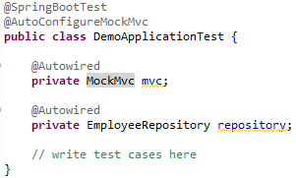
Integration Testing with @SpringBootTest
Is used when bootstrapping the entire container is needed.
The annotation works by creating the ApplicationContext that will be utilized in our tests.

Slide 8
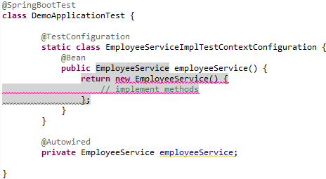
Test Configuration with @TestConfiguration
Avoid bootstrapping the real application context but use a special test configuration.
Two way to implement test configuration class: Static inner class or Public class.

Slide 9
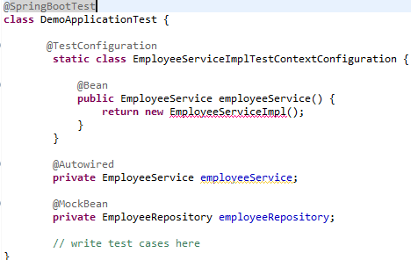
Mocking with @MockBean
Don't need to know or care about how the persistence layer is implemented.
Able to write and test our Service layer code without wiring in our full persistence layer.

Slide 10
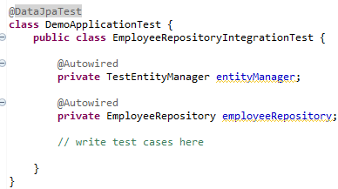
Integration Testing with @DataJpaTest
Provides some standard setup needed for testing the persistence layer: Configure in-memory database, setting Hibernate, Spring Data and the Data Source, perform @EntityScan, support SQL Logging.
The Spring Boot TestEntityManager is an alternative to the standard JPA EntityManager that provides methods commonly used when writing tests.

Slide 11
Unit Testing with @WebMvcTest
Auto-configure the Spring MVC infrastructure for our unit tests.
Limited to bootstrap a single controller. We can also use it along with @MockBean to provide mock implementations for any required dependencies.
@WebMvcTest also auto-configures MockMvc.

Slide 12

Thank You!

